Slide 1
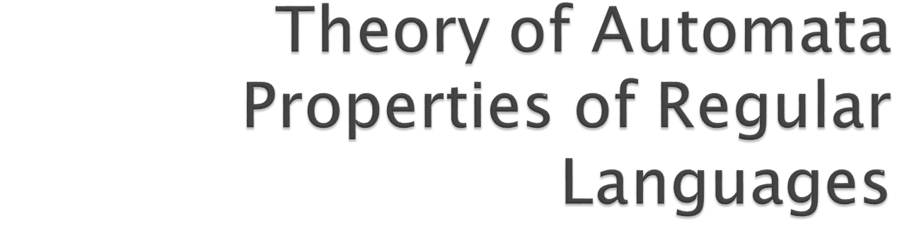

Slide 2
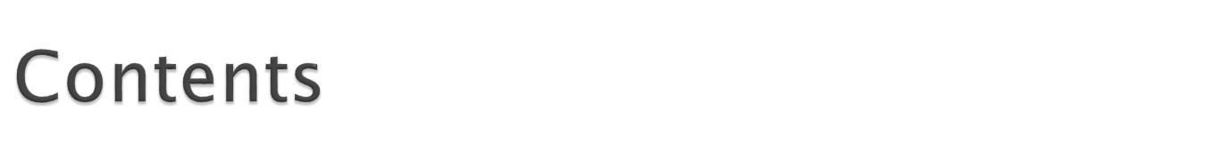
Closure Properties
  Union
  Concatenation
  Power
  Complementation
  Intersection
Theory of Automata

Slide 3

A language that can be defined by a regular expression is called a regular language.
Not all languages are regular, as we shall see in the next lecture.
In this lecture we will focus on the class of all regular languages and discuss some of their properties.
Theory of Automata

Slide 4
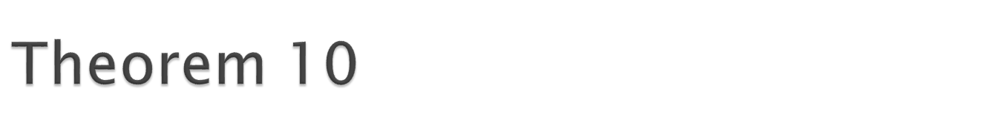
If L₁ and L₂ are regular languages, then L₁ + L₂, L₁L₂, and L*₁ are also regular languages.
Notes:
L₁ + L₂ is the language of all words in either L₁ or L₂.
L₁L₂ is the product language of all words formed by concatenating a word form L₁ with a word from L₂.
L₁ is the language of all words that are the concatenation of arbitrarily many factors from L₁*.
The result stated in Theorem 10 is often expressed as “The set of regular languages is closed under union, concatenation, and Kleene closure”.
Theory of Automata

Slide 5
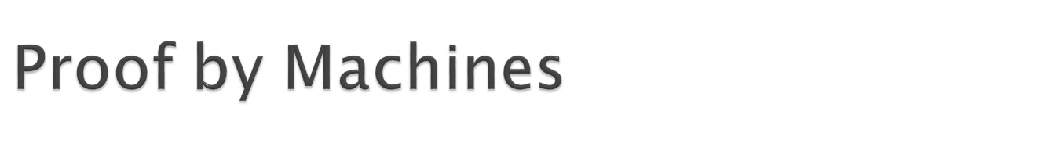
Because L₁ and L₂ are regular languages, there must be TGs that accept them (by Kleene’s theorem).
Let TG₁ accepts L₁ and TG₂ accepts L₂.
Assume that TG₁ and TG₂ each have a unique start state and a unique separate final state. If this is not the case originally, then we can modify the TGs so that this becomes true as in Kleene’s theorem,Part 2 of the proof (page 93).
Theory of Automata

Slide 6
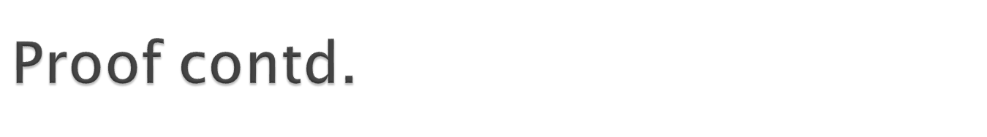
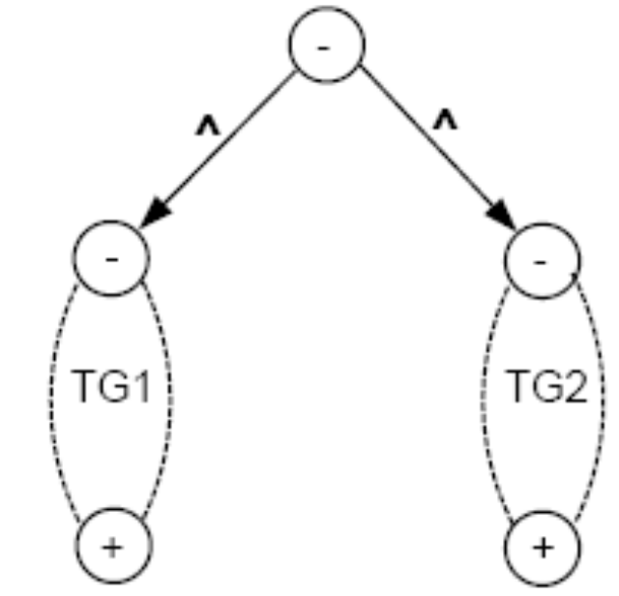
Then the TG described below accepts the language L₁ + L₂.
By Kleene’s theorem, since L₁ + L₂ is defined by this TG, it is also defined by a regular expression and hence is a regular language.
Theory of Automata

Slide 7

The TG described below accepts the language L₁L₂ where state 1 is the former + of TG₁ and state 2 is the former - of TG₂.
Since L₁L₂ is defined by this TG, it is also defined by a regular expression by Kleene’s theorem, and therefore it is a regular language.
Theory of Automata

Slide 8
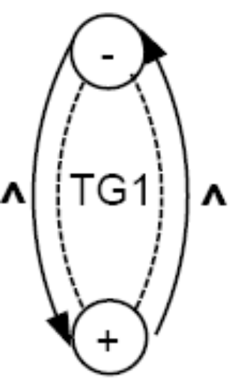
The TG described below accepts the language L₁*.
We begin at the - state and trace a path to the + state of TG1. At this point, we could stop and accept the string or jump back, at no cost, to the - state and run another segment of the input string.
Theory of Automata

Slide 9
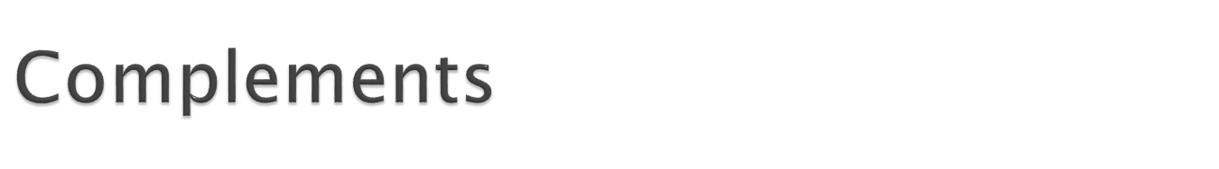
Definition:
If L is a language over the alphabet , we define its complement L` to be the language of all strings of letters from that are not words in L.
Example:
– Let L be the language over the alphabet ∑ = {a; b} of all words that have a double a in them.
– Then, L` is the language of all words that do not have a double a in them.
Note that the complement of L` is L. That is
(L`)` = L
Theory of Automata

Slide 10
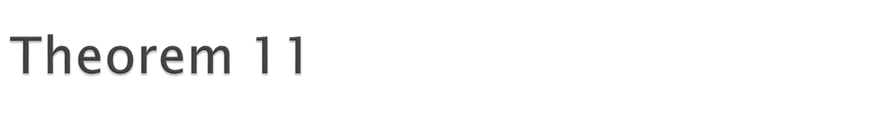
If L is a regular language, then L` is also a regular language. In other words, the set of regular languages is closed under complementation.
Theory of Automata

Slide 11
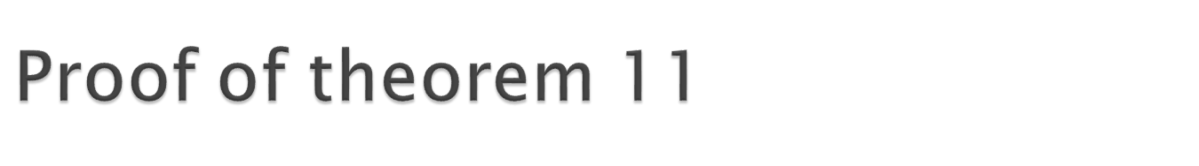
If L is a regular language, then by Kleene’s theorem, there is some FA that accepts the language L.
Some states of this FA are final states and some are not. Let us reverse the status of each state: If it was a final state, make it a non-final state. If it was a non-final state, make it a final state. The start state gets reversed as follows: - ↔ ±
If an input string formerly ended in a non-final state, it now ends in a final state, and vice versa.
The new machine we have just built accepts all input strings that were not accepted by the original FA, and it rejects all the input strings that used to be accepted by FA.
Therefore, this machine accepts exactly the language L`. So, by Kleene’s theorem, L` is regular.
Theory of Automata

Slide 12

If L₁ and L₂ are regular languages, then L₁ ∩ L₂ is also a regular language. In other words, the set of regular languages is closed under intersection.
Theory of Automata

Slide 13
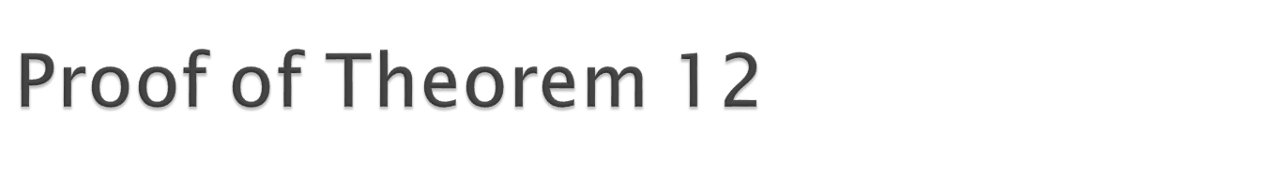
By DeMorgan’s law (for sets of any kind):
L₁ ∩ L₂ = (L`₁ + L`₂)`
This means that the language L₁ ∩ L₂ consists of all words that are not in either L`₁ or L`₂.
Because L₁ and L₂ are regular, then so are L`₁ and L`₂ by Theorem 11.
Since L`₁ and L`₂ are regular, so is L`₁ + L`₂ by Theorem 10.
Now, since L`₁ + L`₂ is regular, so is (L`₁ + L`₂)` by Theorem 11.
This means L1 ∩ L2 is regular, because
L1 ∩ L2 = (L`₁ + L`₂)` by DeMorgan’s law.
Theory of Automata

